Slide 1
DataBase

Slide 2
Data Modeling
using Entity–Relationship (ER) Model

Slide 3
Entity–Relationship (ER) Model
high-level conceptual data model

Slide 4
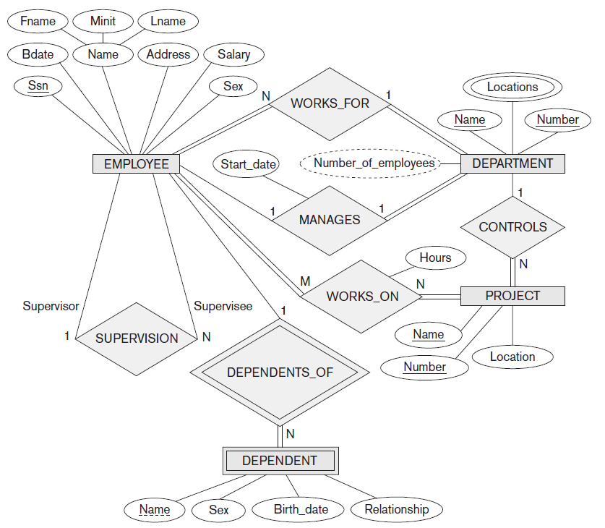
Entity–Relationship
ER diagram

Slide 5
Object Orietend modeling methodologies such as the Unified Modeling Language (UML) are popular in both database and software design; these methodologies go beyond database design to specify detailed design of software modules and their interactions using various types of diagrams
part of these methodologies, class diagrams, are similar in many ways to ER diagrams

Slide 6
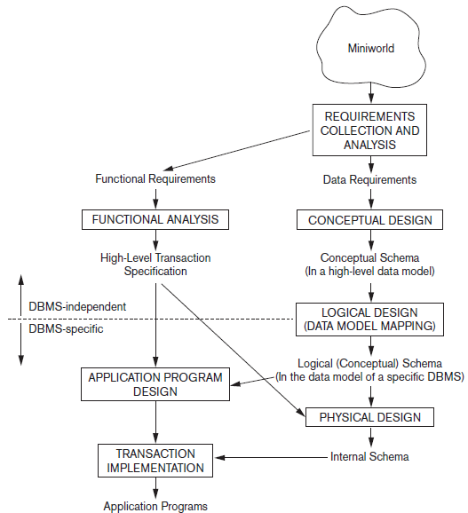
main phases of database design

Slide 7
Using High-Level Conceptual Data Models for Database Design
previous figure shows a simplified overview of database design process
first step shown is requirements collection and analysis
interview prospective users to understand their data requirements and the known functional requirements of the application
user defined operations (or transactions) that will be applied to database
in software design, it is common to use data flow diagrams, sequence diagrams, scenarios, and other techniques to specify functional requirements
once the requirements have been collected and analyzed, next step is to create a conceptual schema for database, using high-level conceptual data model

Slide 8
Conceptual Design
step is called conceptual design; conceptual schema is a concise description of the data requirements of the users and includes detailed descriptions of the entity types, relationships, and constraints; expressed using concepts provided by the high-level data model
these concepts do not include implementation details, easier to understand and can be used to communicate with nontechnical users
conceptual schema can also be used as a reference to ensure that all users’ data requirements are met
database designers specifying the properties of the data, without being concerned with storage and implementation details

Slide 9
next step in database design is the actual implementation of database, using commercial DBMS
conceptual schema is transformed from high-level data model into implementation data model
step is called logical design or data model mapping; its result is a database schema in the implementation data model of the DBMS
last step is the physical design phase, during which the internal storage structures, file organizations, indexes, access paths, and physical design parameters for the database files are specified

Slide 10
application programs are designed and implemented as database transactions corresponding to high-level transaction specifications

Slide 11
sample database application
sample database application, called COMPANY
COMPANY database keeps track of company’s employees, departments, and projects
description of the miniworld — part of the company that will be represented in the database

Slide 12
company is organized into departments; each department has a unique name, unique number, and a particular employee who manages the department
we keep track of the start date when that employee began managing the department
department may have several locations
department controls a number of projects, each of which has a unique name, unique number, and a single location

Slide 13
database will store each employee’s name, Social Security number, address, salary, sex (gender), and birth date
employee is assigned to one department, but may work on several projects, which are not necessarily controlled by the same department
it is required to keep track of current number of hours per week that an employee works on each project, as well as the direct supervisor of each employee (who is another employee)
database will keep track of the dependents of each employee for insurance purposes, including each dependent’s first name, sex, birth date, and relationship to the employee

Slide 15
Entity–Relationship (ER) Model
describes data as entities, relationships, and attributes

Slide 16
Entities and their Attributes
basic concept that the ER model represents is an entity, which is a thing or object in the real world with an independent existence
  object with physical existence (person, car, house, or employee)
  object with conceptual existence (company, job, or university course)
each entity has attributes, particular properties that describe it
  for example, an EMPLOYEE entity may be described by employee’s name, age, address, salary, and job
particular entity will have values for attributes; values that describe entity become part of the data stored in the database

Slide 17
several types of attributes occur in the ER model: simple versus composite, single valued versus multi-valued, and stored versus derived

Slide 18
Composite versus Simple (Atomic) Attributes
composite attributes can be divided into smaller subparts, which represent more basic attributes with independent meanings
for example, the Address attribute of the EMPLOYEE entity can be subdivided into Street_address, City, State, and Zip_code
attributes that are not divisible are called simple or atomic attributes
composite attributes can form a hierarchy; for example, Street_address can be further subdivided into three simple component attributes: Number, Street, and Apartment_number, …
value of composite attribute is the concatenation of the values of its component simple attributes

Slide 19
composite attributes are useful to model situations in which a user sometimes refers to composite attribute as a unit but at other times refers specifically to its component
just send mail at address / search for people from a city
if composite attribute is referenced only as a whole, there is no need to subdivide it into component attributes; for example, if there is no need to refer to individual components of an address then whole address can be designated as simple attribute

Slide 20
Single-Valued versus Multivalued Attributes
most attributes have a single value for a particular entity
for example, age is a single-valued attribute of a person
Real Madrid are los blancos / Barcelona are blau grana
in some cases an attribute can have a set of values for same entity, for instance, a Colors attribute for car, or a College_degrees attribute for person
  one person may not have any college degrees
  another person may have one
  a third person may have two or more degrees

Slide 21
Single-Valued versus Multivalued Attributes
different people can have different numbers of values for College_degrees attribute
such attributes are called multivalued
multivalued attribute may have lower and upper bounds to constrain the number of values allowed for each individual entity

Slide 22
Stored versus Derived Attributes
in some cases, two (or more) attribute values are related, for example, the Age and Birth_date attributes of a person;
for particular person entity, value of Age can be determined from current (today’s) date and value of that person’s Birth_date
Age attribute is hence called a derived attribute and is said to be derivable from the Birth_date attribute, which is called a stored attribute
some attribute values can be derived from related entities; for example, attribute Number_of_employees of DEPARTMENT entity can be derived by counting the number of employees related to (working for) that department

Slide 23
NULL Values
in some cases, particular entity may not have applicable value for an attribute; for example, the Apartment_number attribute of address applies only to addresses that are in apartment buildings and not to other types of residences, such as single-family homes
for such situations, a special value called NULL is created
person with no college degree would have NULL for College_degrees, not applicable
if we do not know home phone number of employee meaning of NULL is unknown

Slide 24
attribute value exists but is missing
attribute values is not known

Slide 25
Complex Attributes
composite and multivalued attributes can be nested arbitrarily

Slide 26
Entity Type, Entity Set
database usually contains groups of entities that are similar
for example, company employing hundreds of employees may want to store similar information concerning each of the employees; these employee entities share the same attributes, but each entity has its own value(s) for each attribute
entity type defines a collection (or set) of entities that have the same attributes; each entity set in database is described by its name and attributes

Slide 27
collection of all entities of a particular entity type in database at any point in time is called entity set or entity collection
entity set is usually referred to using same name as entity type
EMPLOYEE refers to both type of entity as well as current collection of all employee entities in the database
entity type describes the schema or intension for a set of entities that share same structure
collection of entities of a particular entity type is grouped into entity set, which is also called extension of entity type

Slide 28
entity type is represented in ER diagrams as a rectangular box enclosing entity type name
attribute names are enclosed in ovals and are attached to their entity type by straight lines
composite attributes are attached to their component attributes by straight lines
multivalued attributes are displayed in double ovals

Slide 29
Key Attributes of Entity Type
important constraint on entities of an entity type is the key or uniqueness constraint on attributes
entity type usually has one or more attributes whose values are distinct for each individual entity in the entity set; such an attribute (set of attributes) is called key attribute, and its values can be used to identify each entity uniquely
for example, Name attribute is a key of COMPANY entity type; for PERSON entity type, typical key attribute is SSN (Social Security Number)
sometimes several attributes together form a key, meaning that the combination of attribute values must be distinct for each entity

Slide 30
if a set of attributes possesses this property, proper way to represent this in ER model is to define composite attribute and designate it as key attribute
such a composite key must be minimal; that is, all component attributes must be included in composite attribute to have the uniqueness property, superfluous attributes must not be included in key
in ER diagrammatic notation, each key attribute has its name underlined inside oval

Slide 31
key constraint, and other constraints, are derived from the constraints of the miniworld that the database represents
it is not the property of particular entity set; rather, it is a constraint on any entity set of entity type at any point in time
some entity types have more than one key attribute

Slide 32
Value Sets (Domains) of Attributes
each simple attribute of entity type is associated with a value set (or domain of values), which specifies the set of values that may be assigned to that attribute for each individual entity
range of ages allowed for employees is between 16 and 70, can specify value set of Age attribute of EMPLOYEE to be the set of integer numbers between 16 and 70
value sets are not typically displayed in basic ER diagrams and are similar to the basic data types available in most programming languages, such as integer, string, Boolean, float, enumerated type, subrange, and so on

Slide 33
Relationship
implicit relationships among various entity types whenever an attribute of one entity type refers to another entity type, some relationship exists
for example, attribute Manager of DEPARTMENT refers to an employee who manages the department
in the ER model, these references should not be represented as attributes but as relationships
in initial design of entity types, relationships are typically captured in the form of attributes; as design is refined, these attributes get converted into relationships between entity types

Slide 34
Relationship Types, Sets, and Instances
a relationship type R among n entity types E₁, E₂, . . . , E_{n} defines a set of associations or a relationship set among entities from these entity types
mathematically, the relationship set R is a set of relationship instances r_{i}, where each r_{i} associates n individual entities (e₁, e₂, . . . , e_{n}), and each entity e_{j} in r_{i} is a member of entity set E_{j}, 1 ≤ j ≤ n
relationship set is a mathematical relation on E₁, E₂, . . . , E_{n}; alternatively, it can be defined as subset of Cartesian product of the entity sets E₁ × E₂ × . . . × E_{n}. Each of the entity types E₁, E₂, . . . , E_{n} is said to participate in the relationship type R; similarly, each of the individual entities e₁, e₂, . . . , e_{n} is said to participate in relationship instance r_{i} = (e₁, e₂, . . . , e_{n})

Slide 35
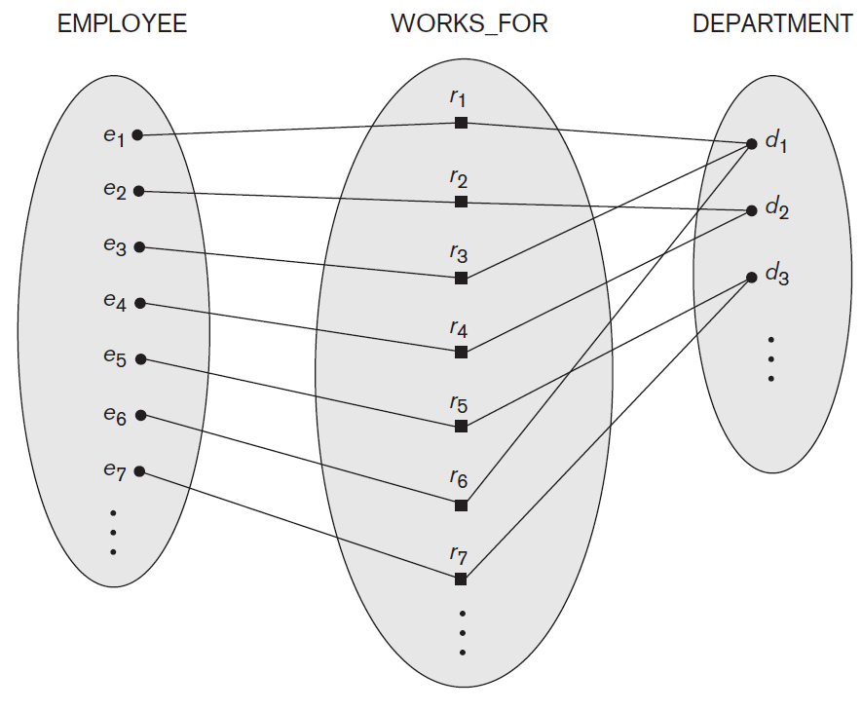
instances in WORKS_FOR relationship set

Slide 36
in ER diagrams, relationship types are displayed as diamond-shaped boxes, which are connected by straight lines to the rectangular boxes representing the participating entity types; relationship name is displayed in the diamond-shaped box

Slide 37
Degree of a Relationship Type
is the number of participating entity types
the WORKS_FOR relationship is of degree two
a relationship type of degree two is called binary, and one of degree three is called ternary; example of a ternary relationship is SUPPLY where each relationship instance r_{i} associates three entities: a supplier s, a part p, and a project j whenever s supplies part p to project j
relationship can be of any degree - most common are binary relationships

Slide 38
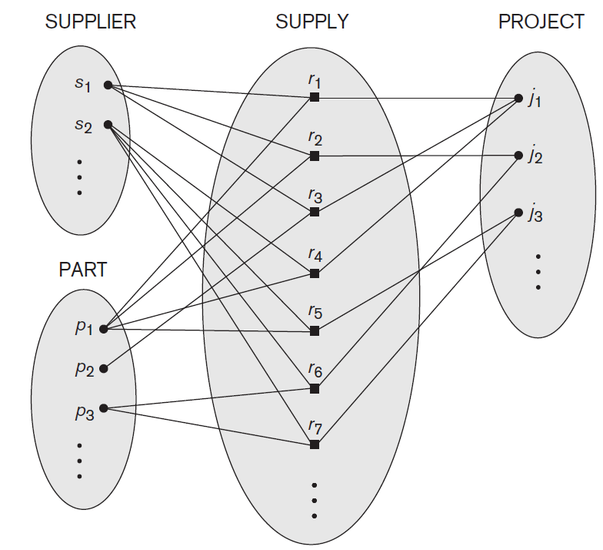

Slide 39
Relationships as Attributes
sometimes convenient to think of a binary relationship type in terms of attributes
consider the WORKS_FOR relationship type; can think of attribute called Department of EMPLOYEE entity type, where the value of Department for each EMPLOYEE entity is (a reference to) the DEPARTMENT entity for which that employee works

Slide 40
Relationships as Attributes
when we think of a binary relationship as attribute, we always have two options or two points of view
alternative point of view is to think of multivalued attribute Employees of entity type DEPARTMENT whose value for each DEPARTMENT entity is the set of EMPLOYEE entities who work for that department

Slide 41
Relationships as Attributes
either of these two attributes: Department of EMPLOYEE or Employees of DEPARTMENT can represent the WORKS_FOR relationship type
if both are represented, they are constrained to be inverses of each other

Slide 42
Role Names
each entity type that participates in a relationship type plays a particular role in the relationship
role name signifies role that participating entity from entity type plays in each relationship instance, and it helps to explain what the relationship means
for example, in WORKS_FOR relationship type, EMPLOYEE plays the role of employee or worker and DEPARTMENT plays the role of department or employer

Slide 43
Recursive Relationship
role names are not technically necessary in relationship types where all participating entity types are distinct, since each participating entity type name can be used as the role name
in some cases, same entity type participates more than once in a relationship type in different roles; in such cases role name becomes essential for distinguishing meaning of the role that each participating entity plays
such relationship types are called recursive relationships or self-referencing relationships

Slide 44
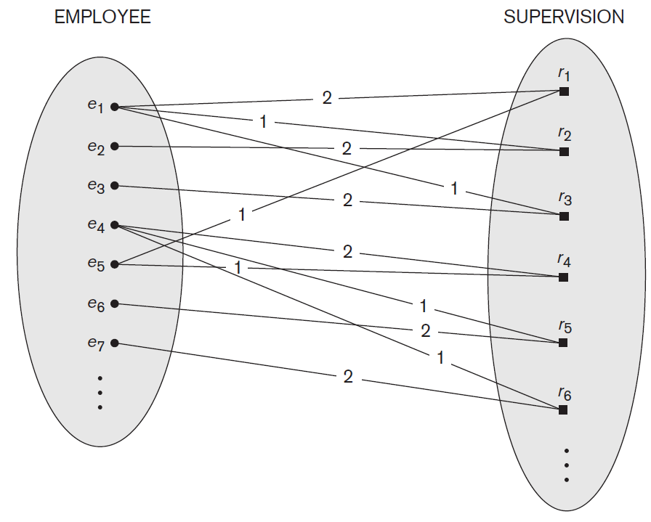

Slide 45
Recursive Relationship
SUPERVISION relationship type relates employee to supervisor, where both employee and supervisor entities are members of same EMPLOYEE entity set; EMPLOYEE entity type participates twice in SUPERVISION: once in the role of supervisor (or boss or master), and once in the role of supervisee (or subordinate or slave)
each relationship instance r_{i} in SUPERVISION associates two different employee entities e_{j} and e_{k}, one of which plays the role of supervisor and the other the role of supervisee
in figure lines marked ‘1’ represent supervisor role, and those marked ‘2’ represent the supervisee role

Slide 46
Constraints on Binary Relationship Types
that limit possible combinations of entities that may participate in corresponding relationship set
constraints are determined from the miniworld
for example, if the company has a rule that each employee must work for exactly one department
can distinguish two main types of binary relationship constraints: cardinality ratio and participation; taken together, as the structural constraints of a relationship type

Slide 47
Cardinality Ratios
specifies the maximum number of relationship instances that an entity can participate in
for example, in WORKS_FOR binary relationship type, DEPARTMENT:EMPLOYEE is of cardinality ratio 1:N, meaning that each department can be related to (that is, employs) any number of employees (N), but an employee can be related to (work for) at most one department (1)
possible cardinality ratios for binary relationship types are 1:1, 1:N, N:1, and M:N

Slide 48
example of a 1:1 binary relationship is MANAGES which relates a department entity to employee who manages that department
represents the miniworld constraints that an employee can manage at most one department, and a department can have at most one manager
relationship type WORKS_ON is of cardinality ratio M:N, because the miniworld rule is that an employee can work on several projects and a project can have several employees

Slide 49
cardinality ratios for binary relationships are represented on ER diagrams by displaying 1, M, and N on the diamonds
can either specify no maximum (N) or a maximum of one (1)
alternative notation allows the designer to specify a specific maximum number on participation

Slide 50
Participation Constraints and
Existence Dependencies
participation constraint specifies whether the existence of an entity depends on its being related to another entity via the relationship type
constraint specifies the minimum number of relationship instances that each entity can participate in and is sometimes called the minimum cardinality constraint
two types of participation constraints: total and partial

Slide 51
Participation Constraints and
Existence Dependencies
if company policy states that every employee must work for a department, then an employee entity can exist only if it participates in at least one WORKS_FOR relationship instance; thus, the participation of EMPLOYEE in WORKS_FOR is called total participation
also called existence dependency do not expect every employee to manage a department, so participation of EMPLOYEE in the
MANAGES relationship type is partial, meaning that some or part of set of employee entities are related to some department entity via MANAGES, but not necessarily all

Slide 52
do not expect every employee to manage a department, so participation of EMPLOYEE in the
MANAGES relationship type is partial, meaning that some or part of the set of
employee entities are related to some department entity via MANAGES, but not necessarily all

Slide 53
in ER diagrams, total participation (or existence dependency) is displayed as a double line connecting participating entity type to relationship, whereas partial participation is represented by single line
alternative notation allows designer to specify specific minimum number on participation in relationship

Slide 54
Attributes of Relationship Types
relationship types can also have attributes, similar to those of entity types
for example, to record number of hours per week that particular employee works on particular project

Slide 55
another example is to include the date on which manager started managing department via an attribute Start_date for MANAGES relationship type
can be an attribute of either EMPLOYEE (manager) or DEPARTMENT, although conceptually it belongs to MANAGES - because MANAGES is a 1:1 relationship
for a 1:N relationship type, relationship attribute can be migrated only to entity type on the N-side of relationship

Slide 56
for M:N (many-to-many) relationship types, some attributes may be determined by the combination of participating entities in a relationship instance, not by any single entity; such attributes must be specified as relationship attributes
an example is the Hours attribute of the M:N relationship WORKS_ON; number of hours per week an employee currently works on a project

Slide 57
Weak Entity Types
entity types that do not have key attributes of their own are called weak entity types
In contrast, regular entity types that do have a key attribute are called strong entity types
entities belonging to a weak entity type are identified by being related to specific entities from another entity type in combination with one of their attribute values
call this other entity type the identifying or owner entity type, and we call the relationship type that relates a weak entity type to its owner the identifying relationship of the weak entity type

Slide 58
weak entity type always has a total participation constraint (existence dependency) with respect to its identifying relationship because weak entity cannot be identified without an owner entity
in general, any number of levels of weak entity types can be defined

Slide 59
not every existence dependency results in a weak entity type
for example, a DRIVER_LICENSE entity cannot exist unless it is related to a PERSON entity, even though it has its own key (License_number) and hence is not a weak entity

Slide 60
entity type DEPENDENT, related to EMPLOYEE, used to keep track of the dependents of each employee via a 1:N relationship
two dependents of employees may, by chance, have same values for Name, Birth_date, Sex, and Relationship, but they are still distinct entities, identified as distinct entities only after determining particular employee entity to which each dependent is related
each employee entity is said to own dependent entities that are related to it

Slide 61
weak entity type normally has partial key, which is the attribute that can uniquely identify weak entities that are related to same owner entity
assume that no two dependents of the same employee ever have the same first name, attribute Name of DEPENDENT is partial key

Slide 62
in ER diagrams, both a weak entity type and its identifying relationship are distinguished by surrounding their boxes and diamonds with double lines
partial key attribute is underlined with a dashed or dotted line

Slide 64
Proper Naming of Schema Constructs
choice of names for entity types, attributes, relationship types, and roles
be consistent!
English it is better then Romanian with the exception of reservered keywords line user

Slide 65
Proper Naming of Schema Constructs
choice of names for entity types, attributes, relationship types, and roles
choose to use singular names for entity types, rather than plural ones, because entity type name applies to each individual entity belonging to that entity type
in sample ER diagrams, use the convention that entity type and relationship type names are in uppercase letters, attribute names have their initial letter capitalized, and role names are in lowercase letters

Slide 66
nouns appearing in narrative tend to give rise to entity type names
verbs tend to indicate names of relationship types
attribute names generally arise from additional nouns that describe the nouns corresponding to entity types

Slide 67
the schema design process should be considered an iterative refinement process …

Slide 68
ER diagram for a UNIVERSITY database schema

Slide 69
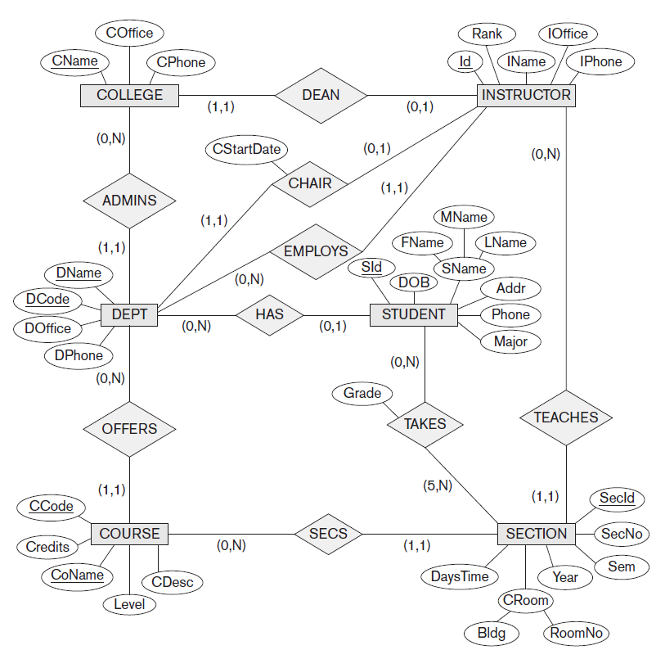

Slide 70
Enhanced Entity–Relationship
(EER) Model

Slide 71
Has-a
a Department has a Employee
in Object-Oriented Programming Has-a relationship implies that instance of one class has a reference to instance of another class

Slide 72
Is-A
a Student is a Person
represents inheritance, for example, a Car is-a Vehicle means the Car class inherits from class Vehicle
Has-A represents composition

Slide 73
both historical data models (hierarchical, network) and current relational data model were filled with many examples of has a relationships like a Product have many Parts, …

Slide 74
features that have been proposed for semantic data models
ER model can be enhanced to include these concepts
leads to Enhanced Entity-Relationship (EER) model
class/subclass relationships
type inheritance
specialization and generalization

Slide 75
Enhanced Entity–Relationship (EER) Model
includes all modeling concepts of the Entity-Relationship model
in addition, it includes concepts of subclass and superclass and related concepts of specialization and generalization

Slide 76
Subtype
for example, entity type EMPLOYEE; in many cases entity type has numerous subgroupings or subtypes of its entities that are meaningful and need to be represented explicitly because of their significance to database application
for example, entities that are members of EMPLOYEE entity type may be distinguished further into SECRETARY, ENGINEER, MANAGER, TECHNICIAN, SALARIED_EMPLOYEE, HOURLY_EMPLOYEE, and so on
set of entities in each of the latter groupings is a subset of entities that belong to EMPLOYEE entity set, meaning that every entity that is member of one of these subgroupings is also an employee

Slide 77
call each of these subgroupings a subclass or subtype of EMPLOYEE entity type, and the EMPLOYEE entity type is called the superclass or supertype for each of these subclasses
relationship between a superclass and any one of its subclasses it is called superclass/subclass or supertype/subtype relationship
a member entity of the subclass represents the same real-world entity as some member of the superclass;
for example, a SECRETARY entity ‘Daniela Crudu’ is also the EMPLOYEE ‘Daniela Crudu’
subclass member is the same as the entity in the superclass, but in a distinct specific role

Slide 78
an entity cannot exist in database merely by being a member of a subclass; it must also be member of superclass; such an entity can be included optionally as member of any number of subclasses
for example, salaried employee who is engineer belongs to two subclasses ENGINEER and SALARIED_EMPLOYEE of the EMPLOYEE entity type
however, it is not necessary that every entity in a superclass is a member of some subclass

Slide 79
Type Inheritance
because an entity in the subclass represents the same real-world entity from the superclass, it should possess values for its specific attributes as well as values of its attributes as a member of the superclass
entity that is a member of subclass inherits all attributes of entity as a member of superclass; entity also inherits all relationships in which the superclass participates
a subclass, with its own specific, or local, attributes and relationships together with all the attributes and relationships it inherits from superclass, can be considered entity type in its own right

Slide 80
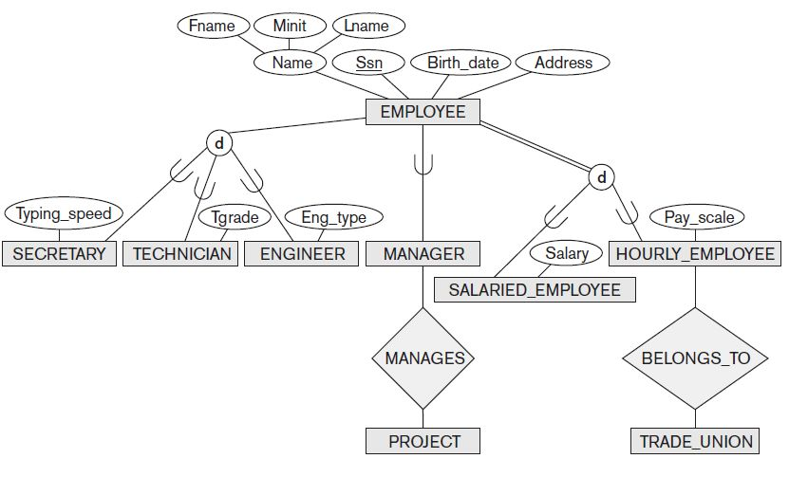

Slide 81
Specialization
is the process of defining a set of subclasses of an entity type; this entity type is called superclass of specialization
set of subclasses that forms specialization is defined on the basis of some distinguishing characteristic of the entities in the superclass
for example, specialization of EMPLOYEE entity type may yield the set of subclasses {SALARIED_EMPLOYEE, HOURLY_EMPLOYEE}; specialization distinguishes among employees based on the method of pay

Slide 82
Secretary Kim attributes:
  Typing_speed
  Name
  SSN
  Birthdate
  Address
to get her net worth we have to access Employee and then either Salary or Pay_scale

Slide 83
Student’s attributes in University information system
  Name
  SSN
  Group
  Faculty

Slide 84
Faculty’s – faculty staff attributes in University information system
  Name
  SSN
  Title
  Department
  Faculty

Slide 85
Person’s attributes in University information system
  Name
  SSN

Slide 86
reasons for including class/subclass relationships and specializations
certain attributes may apply to some but not all entities of superclass entity type; subclass is defined in order to group the entities to which these attributes apply; members of subclass may still share majority of their attributes with other members of superclass
some relationship types may be participated in only by entities that are members of the subclass
  for example, only HOURLY_EMPLOYEES can belong to trade union

Slide 87
Generalization
reverse process of abstraction in which we suppress differences among several entity types, identify their common features, and generalize them into a single superclass of which the original entity types are special subclasses

Slide 88
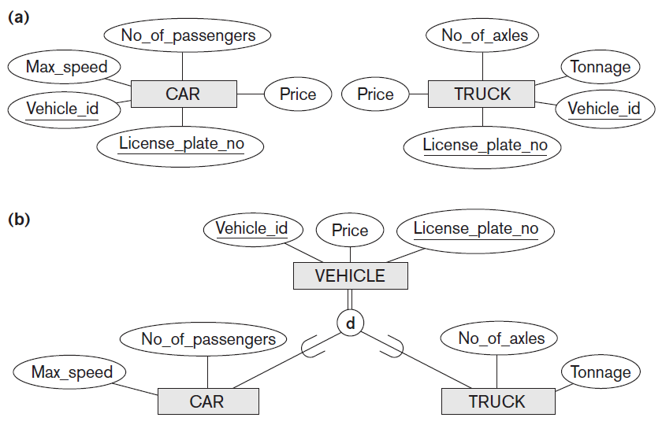

Slide 89
for example, entity types CAR and TRUCK have several common attributes, they can be generalized into entity type VEHICLE
use term generalization to refer to the process of defining generalized entity type from given entity types
generalization process can be viewed as being functionally the inverse of specialization process
decision as to which process was followed in particular situation is often subjective

Slide 90
Constraints on Specialization and Generalization
in some specializations we can determine exactly entities that will become members of each subclass by placing a condition on the value of some attribute of the superclass; such subclasses are called predicate-defined (or condition-defined) subclasses
for example, if EMPLOYEE entity type has attribute Job_type can specify condition of membership in SECRETARY / ENGINEER / MANAGER / TECHNICIAN subclass

Slide 91
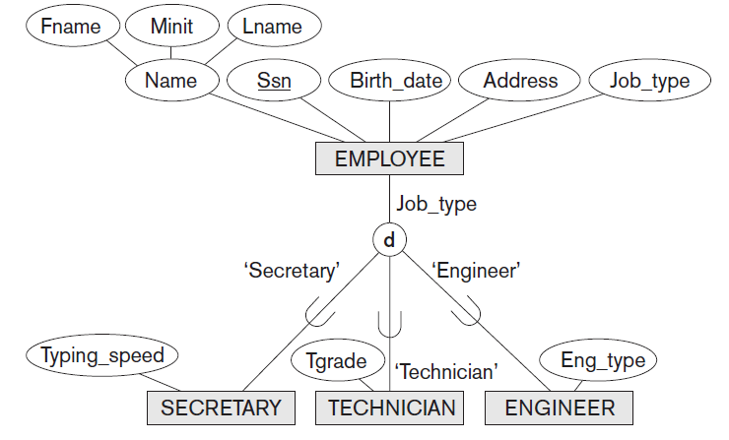

Slide 92
Defining Attribute
if all subclasses in specialization have their membership condition on same attribute of superclass, specialization itself is called attribute-defined specialization, and the attribute is called defining attribute of specialization
all entities with same value for attribute belong to same subclass

Slide 93
User Defined
when do not have condition for determining membership in subclass, subclass is called user-defined
membership in such subclass is determined by database users when they apply operation to add entity to subclass; hence, membership is specified individually for each entity by the user, not by any condition that may be evaluated automatically

Slide 94
Disjoint Constraint
specifies that the subclasses of the specialization must be disjoint sets
means that an entity can be a member of at most one of the subclasses of the specialization
specialization that is attribute-defined implies the disjoint constraint (if attribute used to define membership predicate is single valued)

Slide 95
Overlapping
if subclasses are not constrained to be disjoint, their sets of entities may be overlapping; that is, same (real-world) entity may be a member of more than one subclass of specialization
this case is the default

Slide 96
Completeness Constraint
may be total or partial
total specialization constraint specifies that every entity in superclass must be member of at least one subclass in specialization
  for example, every EMPLOYEE must be either HOURLY_EMPLOYEE or SALARIED_EMPLOYEE; is a total specialization of EMPLOYEE
partial specialization allows an entity not to belong to any of the subclasses
  for example, some EMPLOYEE entities do not belong to any of subclasses {SECRETARY, ENGINEER, TECHNICIAN}; specialization is partial

Slide 97
disjoint and complete constraints
disjoint and complete constraints are independent
  disjoint, total
  disjoint, partial
  overlapping, total
  overlapping, partial
constraint is determined from real-world meaning that applies to each specialization

Slide 98
Cascade Delete
deleting entity from a superclass implies that it is automatically deleted from all subclasses to which it belongs

Slide 99
inserting entity in superclass implies that entity is mandatorily inserted in all predicate-defined (or attribute-defined) subclasses for which entity satisfies defining predicate
inserting entity in superclass of total specialization implies that entity is mandatorily inserted in at least one of subclasses of specialization

Slide 100
One-to-One relationship
One SECRETARY is One EMPLOYEE
One EMPLOYEE is One SECRETARY

Slide 101
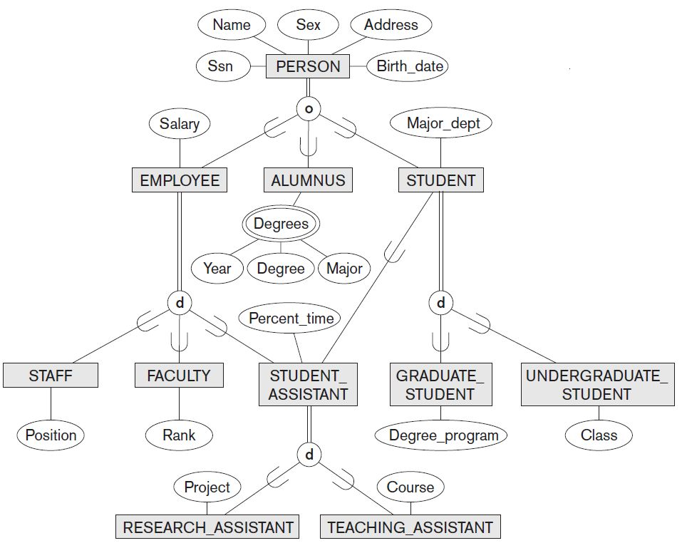
Specialization with Multiple Inheritance for UNIVERSITY

Slide 102
Modeling of UNION Types Using Categories
sometimes necessary to represent a collection of entities from different entity types: subclass will represent a collection of entities that is a subset of the UNION of entities from distinct entity types
call such a subclass a union type or a category

Slide 103
for example, suppose that we have three entity types: PERSON, BANK, and COMPANY in a database for motor vehicle registration
owner of a vehicle can be a person, a bank (holding a lien on a vehicle), or a company
need to create a class (collection of entities) that includes entities of all three types to play the role of vehicle owner
category (union type) OWNER that is a subclass of the UNION of the three entity sets of COMPANY, BANK, and PERSON can be created for this purpose

Slide 104
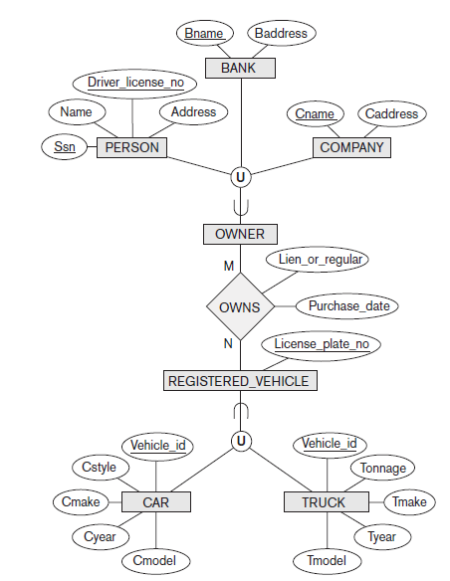
category has two or more superclasses that may represent collections of entities from distinct entity types, whereas other superclass/subclass relationships always have a single superclass

Slide 105
compare a category, such as OWNER with ENGINEERING_MANAGER shared subclass of each of the three superclasses ENGINEER, MANAGER, and SALARIED_EMPLOYEE, so an entity that is a member of ENGINEERING_MANAGER must exist in all three collections
represents the constraint that an engineering manager must be an ENGINEER, a MANAGER, and a SALARIED_EMPLOYEE;
category is a subset of the union of its superclasses
hence, entity that is a member of OWNER must exist in only one of the superclasses
constraint that an OWNER may be a COMPANY, a BANK, or a PERSON

Slide 106
each OWNER entity inherits attributes of a COMPANY, a PERSON, or a BANK, depending on superclass to which entity belongs
shared subclass such as ENGINEERING_MANAGER inherits all the attributes of its superclasses SALARIED_EMPLOYEE, ENGINEER, and MANAGER

Slide 107
Design Choices for Specialization/Generalization
in general, many specializations and subclasses can be defined to make conceptual model accurate
important to represent only those subclasses that are necessary to avoid extreme cluttering of conceptual schema
if a subclass has few specific (local) attributes and no specific relationships, it can be merged into superclass; specific attributes would hold NULL values for entities that are not members of subclass

Slide 108
Design Choices for Specialization/Generalization
if all subclasses of a specialization/generalization have few specific attributes and no specific relationships, they can be merged into superclass and replaced with one or more type attributes that specify subclass or subclasses that each entity belongs to
union types and categories should generally be avoided unless the situation definitely warrants this type of construct, which does occur in some practical situations
  if possible, try to model using specialization/generalization

Slide 109
Design Choices for Specialization/Generalization
choice of disjoint/overlapping and total/partial constraints on specialization/generalization is driven by the rules in the miniworld being modeled
if the requirements do not indicate any particular constraints, default would generally be overlapping and partial, since this does not specify any restrictions on subclass membership

Slide 110
Data Abstraction, Knowledge
Representation, and Ontology Concepts
goal of Knowledge Representation techniques is to develop concepts for accurately modeling some domain of knowledge by creating an ontology that describes concepts of the domain and how these concepts are interrelated
ontology is used to store and manipulate knowledge for drawing inferences, making decisions, or answering questions
goals of Knowledge Representation are similar to those of semantic data models

Slide 111
Semantic Web attempts to create knowledge representation models that are quite general in order to allow meaningful information exchange and search among machines
the concept of ontology is considered to be the most promising basis for achieving the goals of the Semantic Web and is closely related to knowledge representation

Slide 112
ontologies attempts to describe concepts and relationships that are possible in reality through some common vocabulary; therefore, it can be considered as a way to describe the knowledge of a certain community about reality
ontology is a specification of a conceptualization
conceptualization is the set of concepts and relationships that are used to represent the part of reality or knowledge that is of interest to a community of users
specification refers to the language and vocabulary terms that are used to specify the conceptualization

Slide 113
thesaurus (or even a dictionary or a glossary of terms) describes the relationships between words (vocabulary) that represent various concepts
taxonomy describes how concepts of a particular area of knowledge are related using structures similar to those used in a specialization or generalization
detailed database schema is considered by some to be an ontology that describes the concepts (entities and attributes) and relationships of a miniworld from reality
logical theory uses concepts from mathematical logic to try to define concepts and their interrelationships

